Slide 1
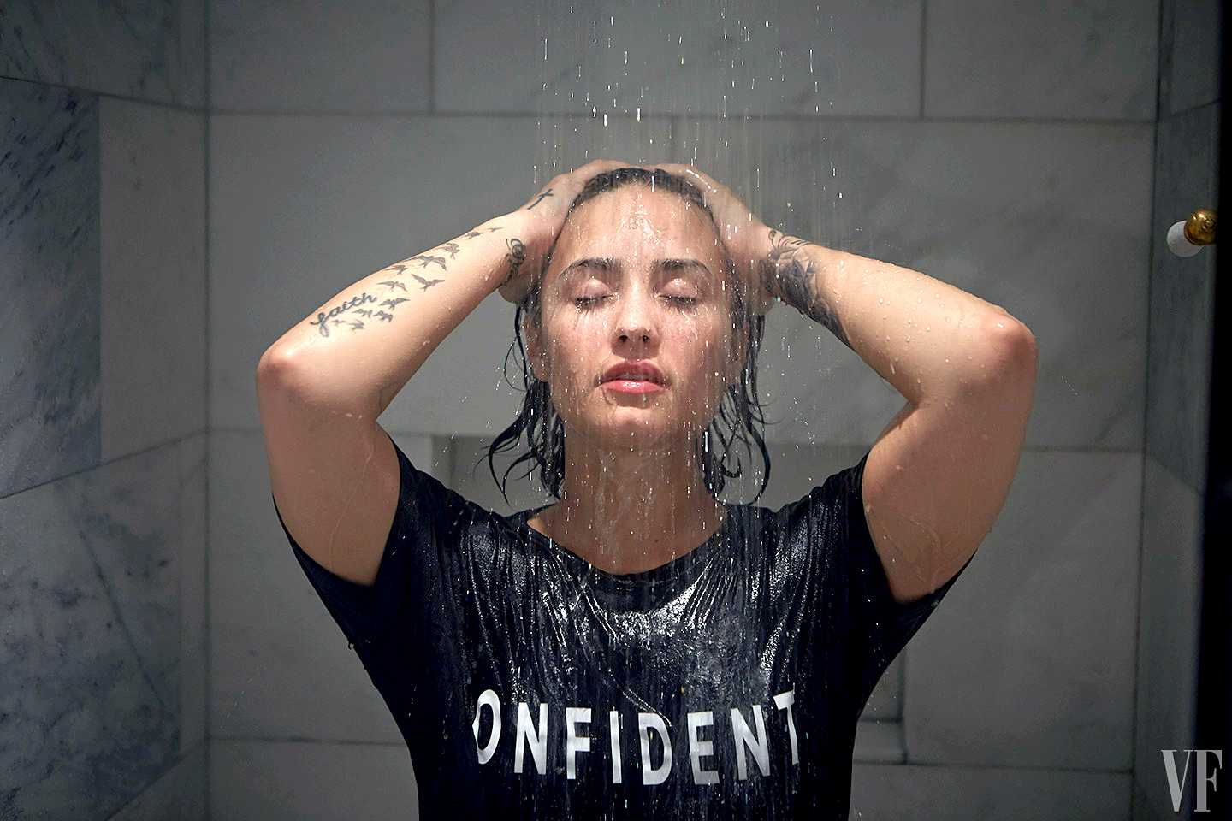

Slide 2
I used to hold my freak back
Now I'm letting go
I make my own choice
Yeah I run this show
So leave the lights on
No, you can't make me behave

